Slide 1
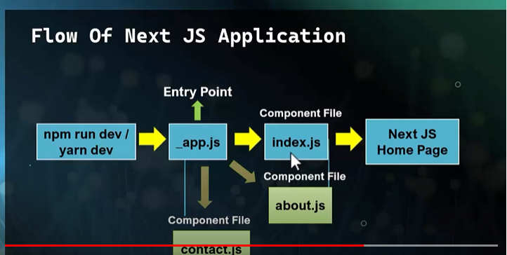
1. Control flow of Next Js.
1*. As we run our application using “npm run dev”- the control flow will goes to _app.js file then this file will execute index.js file. _app.js file will executes more than one / all component files like index.js, home.js, contact.js ect.

Slide 2
* Since firstly control flow goes to _app.js file that’s why it is called entry point of the next Js application.
2*. When we run our application for the first time _app.js file will search for index.js file. If index.js file available then _app.js file will execute index.js. If index.js file not available it will through 404 error.
3*. _app.js component have two arguments- component and pageProps.
4*. All component are received inside ‘component’ ,argument of _app.js file. pageProps receives data of component and return with component.

Slide 3
2. Routing in Next Js
Routing in React Js-
1. Firstly we have to install a third party package i e. ‘react-router-dom’.
2. Then we have to create a file ‘routes.js’ to configure the routes.
3. For every route we have to create a component, export the component, import in routes.js file and then configure new route with path property.
Routing in Next Js-
1.In Next Js there is no need to install any third party package to define the route. As we create new components, next Js application automatically creates route as the name of file.

Slide 4
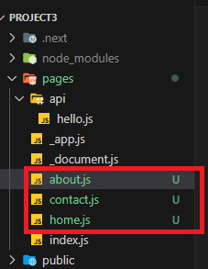
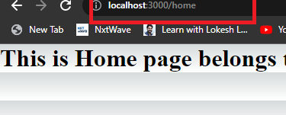
2.1 File Base Routing
1. When a file is added to the page directory in a project, it automatically becomes available as a route, this is called file based routing concept.
2. Next Js defines routes and paths using folders and files.
3. In Next Js we create and export React component file, in a special folder called “pages”. Then next Js will automatically creates route for that particular file.
Just creating files inside pages directory, it’s route automatically will be set.
This is called file based routing.

Slide 5
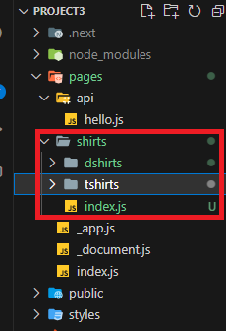
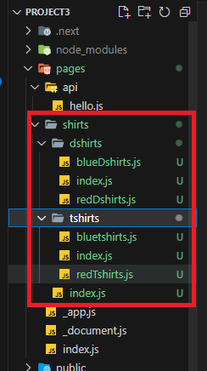
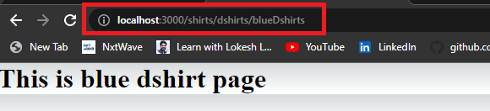
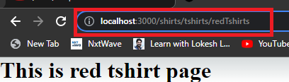
2.2 Nested Routing
1. when one folder is inserted into another folder, called nesting. Routes made by nesting component is called Nested Routing.

Slide 6
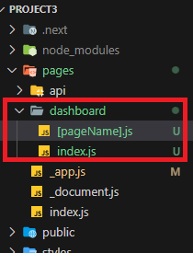
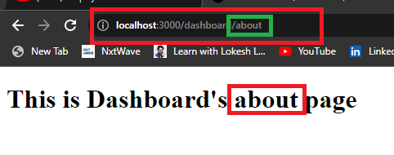
2.3 Dynamic Routes
Dynamic Routes are pages that allow us to add custom params to our URLs
The Syntax of Dynamic route is- [].js

Slide 7
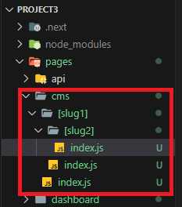
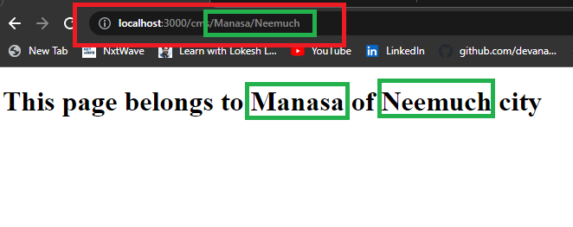
2.4 Nested Dynamic Routes
If one dynamic route is inserted into another dynamic route, is called nested dynamic routes.

Slide 8
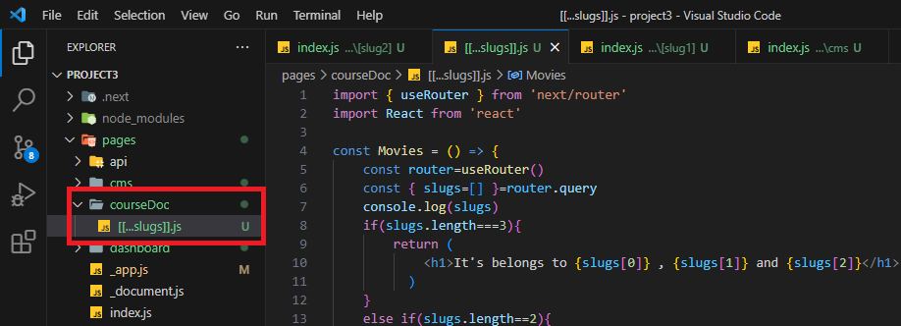
2.5 Catch All Routes
Catch-all routes are useful when we need to handle a varying number of URL segments.

Slide 9
